Slide 1
Multiculturalism in Crisis:40 Years of Housing Illness in a PA Mushroom Town
John Mirsky
Bucknell University, Department of Sociology/Anthropology

Slide 2
Fieldsite: Kennett Square PA

Slide 3
Housing Illness

Slide 4
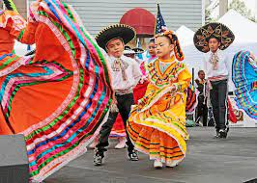
Multicultural Festivals

Slide 5
Semiotics
Floating signifier: a conveyer of meaning detached from any original signification and are entirely socially constructed (Hall 2021, 1997; Mbembe 2017; Heim 2016; Dudek 2006).

Slide 6
Conclusion: Future Steps

Slide 7
Sources
Hall, Stuart 2019. Essential Essays, Volume 2: Identity and Diaspora. Durham, UNITED STATES: Duke University Press.
Hall, Stuart. 2021. Nineteen Race, the Floating Signifier: What More Is There to Say about “Race”? [1997]. Duke University Press.
Mbembe, Achille. 2017. Critique of Black Reason. Duke University Press.

